Slide 1
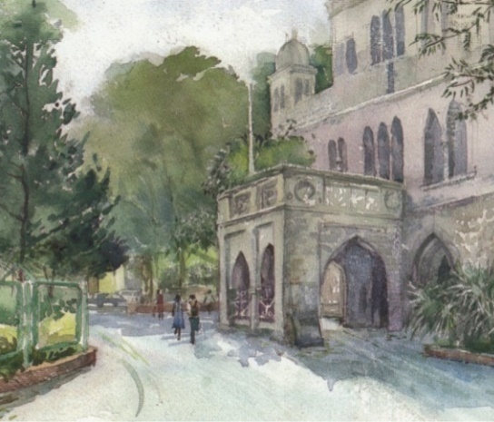


Biology for Engineers (BFE)
NEP Complied Syllabus
ANALOGY OF BIOLOGICAL ORGAN/SYSTEM AND ENGINEERING DEVICE/MECHANISM
----------------------------------------------
UNIT 3
Organ & system: Brain & CPU, Eye & Camera, Kidney & Filtration system, Lungs & purification system, Heart & Pumping system
Process: Photosynthesis & solar cells, xylem & plumbing, thermoregulation in human body & heat transfer in machine, Defense mechanism in organism, Electrical signaling in biology

Slide 2
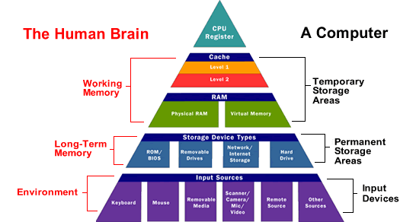
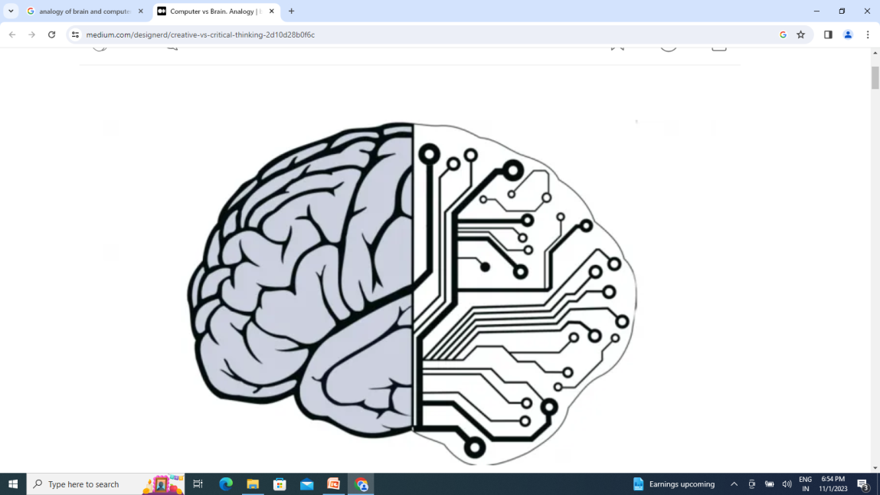
Brain & Computer
Afferent Neurons
Efferent Neurons
 | Human | Computer
Task management | Brain parts | Software
Working memory |  | CPU Cache
Short memory | Hippocampus | RAM
Long memory | Cortex | HD
Programmable | ?? | Yes
 | Neuron network | ANN

Slide 3
Functions of BRAIN
Thoughts and decisions.
Memories and emotions.
Movements (motor function), balance and coordination.
Perception of various sensations including pain.
Automatic behavior such as breathing, heart rate, sleep and temperature control.
Regulation of organ function.
Speech and language functions.
Fight or flight response
The two are superior in different areas, making the comparison of who is "smarter" more difficult. The human brain excels in adaptability, creativity, emotional intelligence, and the ability to absorb complex and unstructured information, but computers are superior in processing speed, memory, and precision

Slide 4
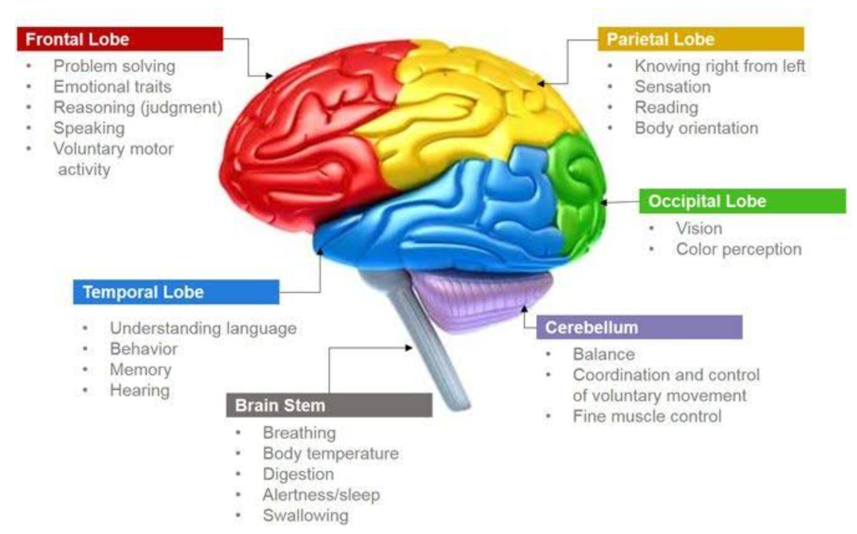
CPU
Image Card
Sound Card

Slide 5
The brain and the central processing unit (CPU) of a computer share several similarities, including:
Data Processing: Both the brain and the CPU manage the timing of operations and carry out instructions.
Electrical signals: Both the brain and the CPU use electrical signals to transmit information. The brain uses neurons, while the CPU uses wires.
Metaphorical thinking: Both the brain and the computer have some ability to think metaphorically.
Parallel Processing: Both the human brain and processors can perform tasks in parallel. The brain processes multiple sensory inputs and tasks simultaneously, and modern processors have multiple cores for parallel processing.
Memory Storage: Both systems use a form of memory storage. The human brain stores information in neurons and synapses, while computer processors use RAM (Random Access Memory) and storage devices.
Learning & Adaptation: The human brain can learn from experience and adapt, and computer processors can be programmed to learn and adapt to specific tasks through machine learning algorithms.

Slide 6
Logical Processing
Both systems can perform logical operations. The brain can make decisions, solve problems, and perform logical reasoning, just as computer processors execute logical operations through their circuits.
Error Correction
Both the human brain and processors have error correction mechanisms. The brain can correct errors in information processing, and processors use error-correcting code (ECC) in memory to identify and correct errors.
Overclocking
Processors can be overclocked to operate at higher speeds, akin to pushing the limits of one’s mental capacity to achieve peak performance in certain tasks.
Heat Management
Both systems generate heat when active and require heat management mechanisms. The human body regulates temperature, while computer processors use fans and heatsinks to dissipate heat.

Slide 7
Other ways to compare the brain and the CPU include:
Visual cortex
The graphics card in a computer is similar to the visual cortex in the brain, which processes visual information.
Auditory cortex
The sound card in a computer is similar to the auditory cortex in the brain, which processes auditory information.
Hippocampus
The hard drive in a computer is similar to the hippocampus in the brain, which is a key memory area.
Prefrontal cortex
The processor or CPU in a computer is similar to the prefrontal cortex in the brain, which is associated with planning, thinking, and problem-solving.

Slide 8
The human brain and a computer differ in many ways, including:
Processing speed: Computers are much faster than the human brain at processing information.
Energy efficiency: The brain is 10 times more energy efficient than a computer.
Memory: The brain has many types of memories and can prioritize them based on importance.
Parallel processing: The brain is massively parallel, meaning it can do more than one thing at a time, while computers are serial devices that can only do one thing at a time.
Architecture: Computers are based on the Von Neumann architecture, while brain circuits are not.
Activity: The brain is always changing and active, even when a person is sleeping, while a computer only changes when new hardware or software is added.
Interpretation: The brain is better at interpreting the outside world and coming up with new ideas.
Vulnerability: The brain is susceptible to fatigue and emotional changes, which can affect its performance.

Slide 9
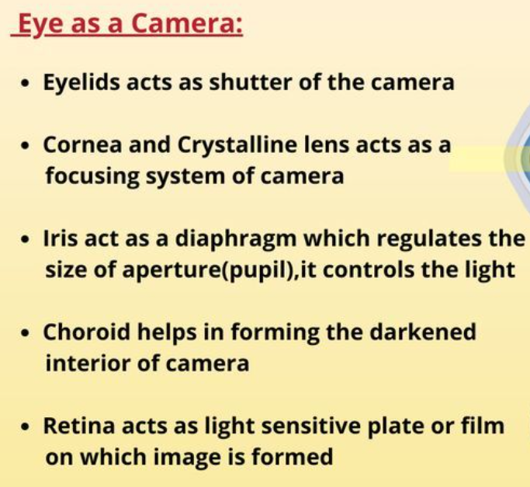
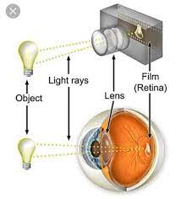
Eye & Camera

Slide 10
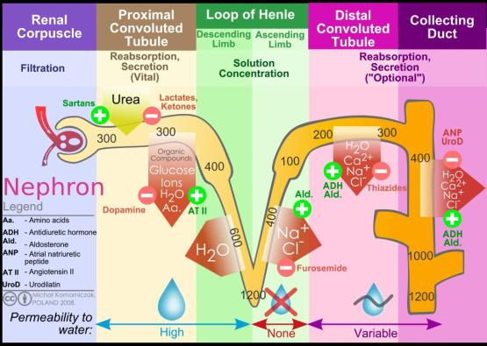

Slide 11
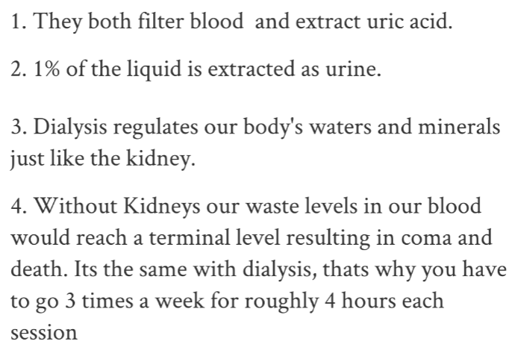
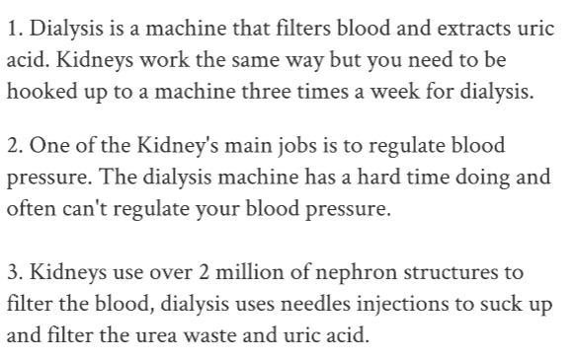

Slide 12
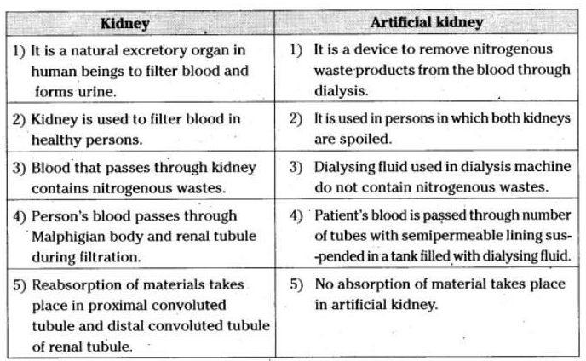

Slide 13
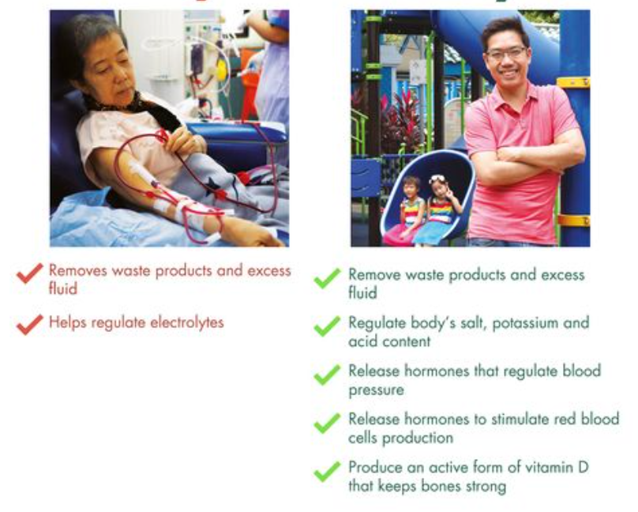

Slide 14
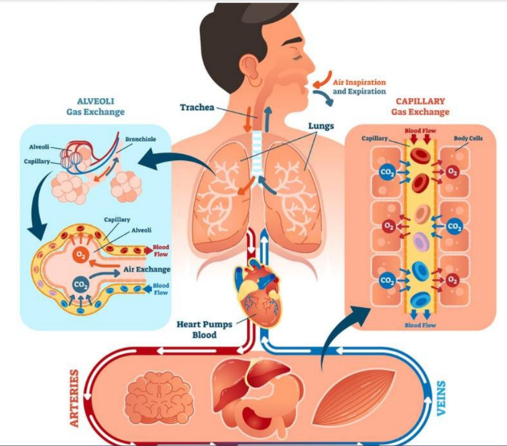
Lungs & Purification

Slide 15
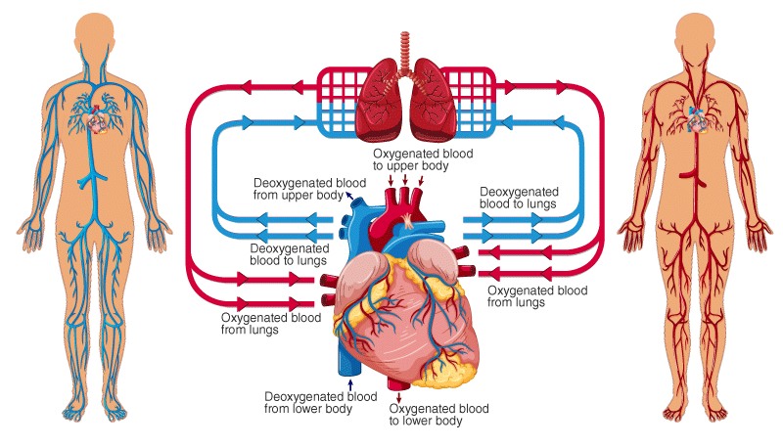
Heart & Pumping

Slide 16
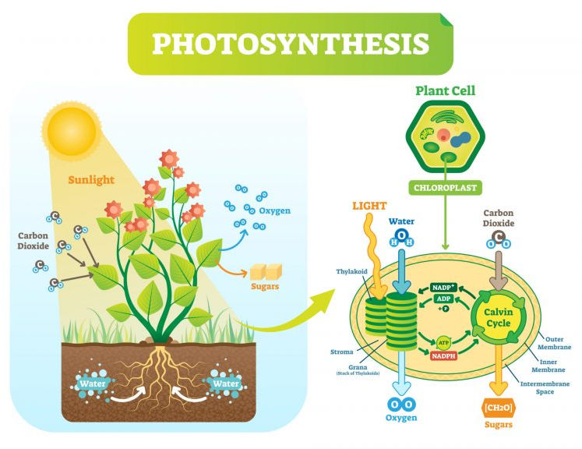
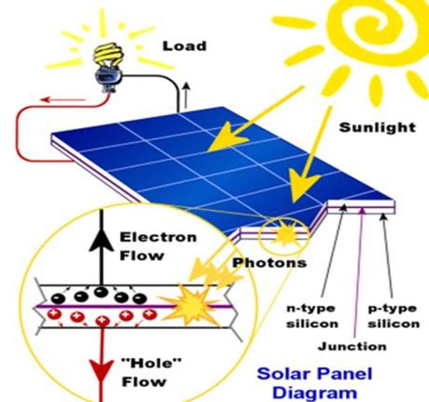
Photosynthesis
Solar cells

Slide 17
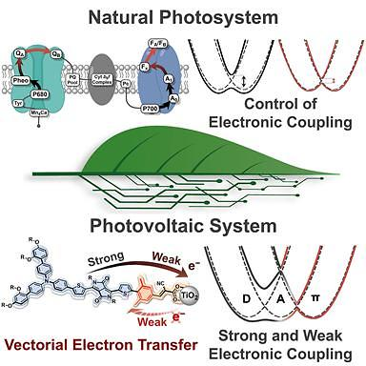

Slide 18
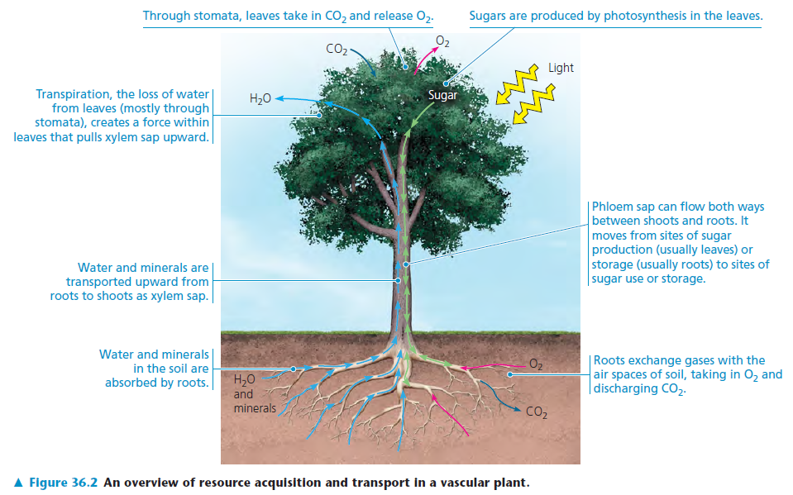
Smart Vascular System in Plants

Slide 19
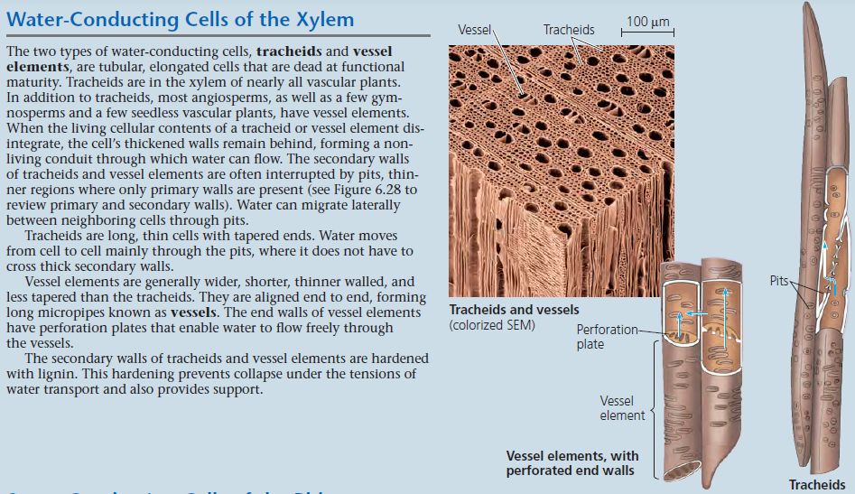

Slide 20
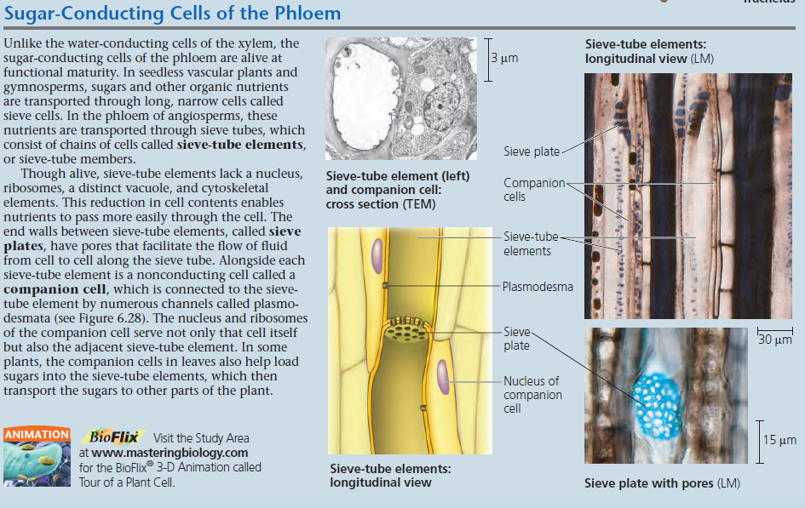

Slide 21
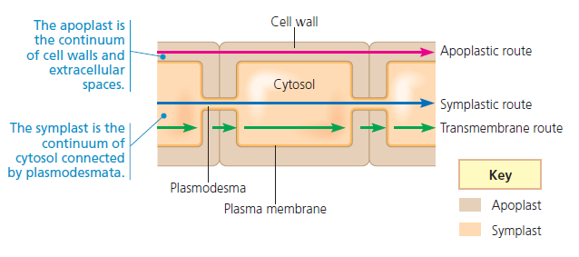
Short Distance
Active & Passive transport mechanism
Water potential & diffusion
Long Distance
Bulk flow in response to the pressure gradient
Positive pressure / Negative pressure

Slide 22
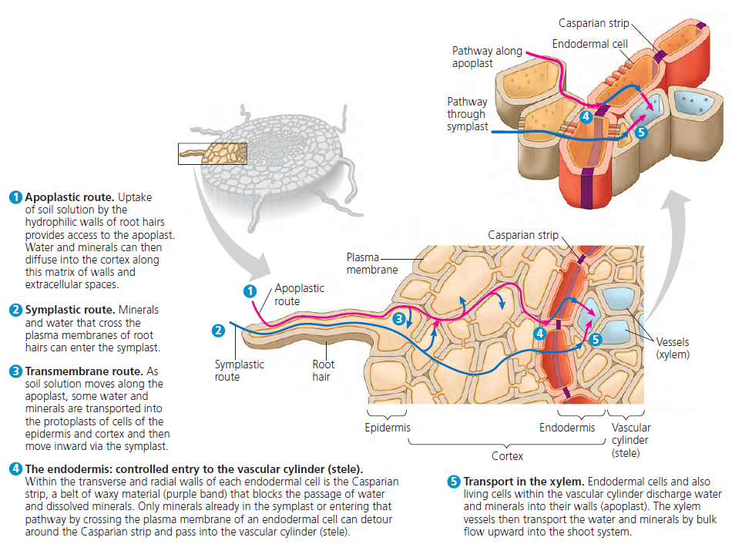

Slide 23
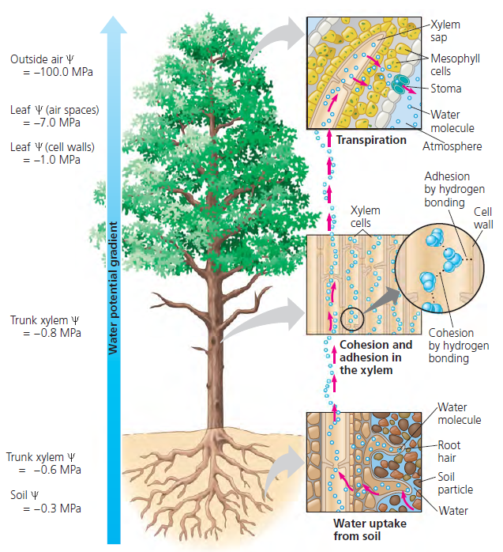
Negative pressure:
Cohesion tension theory
Theories for water uptake through xylem tissue …
Positive pressure:
Root pressure

Slide 24
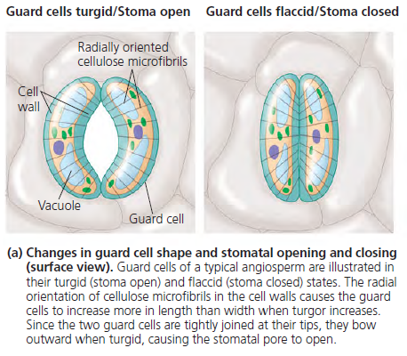

Slide 25
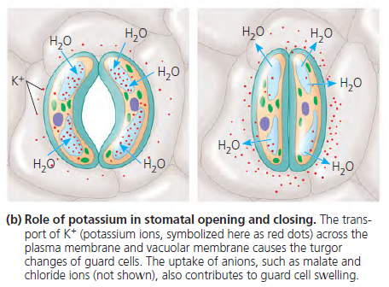

Slide 26
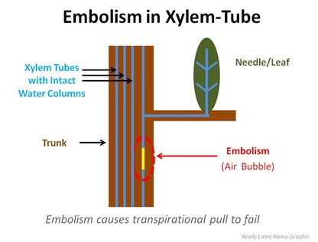
Problems to the water movements through xylem …
Embolism: Xylem vessels are blocked by the air
Solution: Water moves around the obstacle till it gets cleared or a valve like structure (TORUS) offers a bypass for the movement

Slide 27
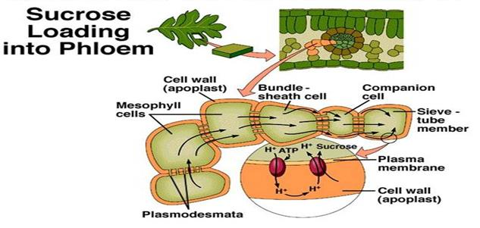
Photosynthetic tissues of plants (autotrophs) have to provide synthesized products to non photosynthetic (heterotrophs).
Carbohydrates are either in the form of starch or sucrose

Slide 28
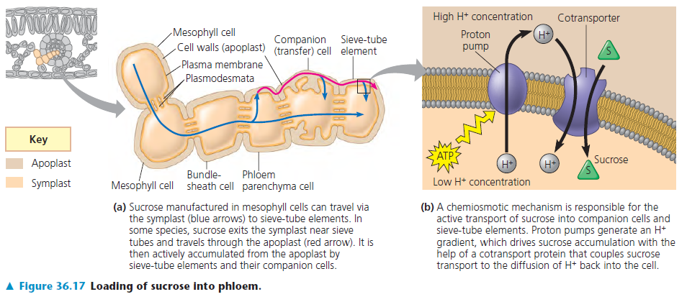

Slide 29
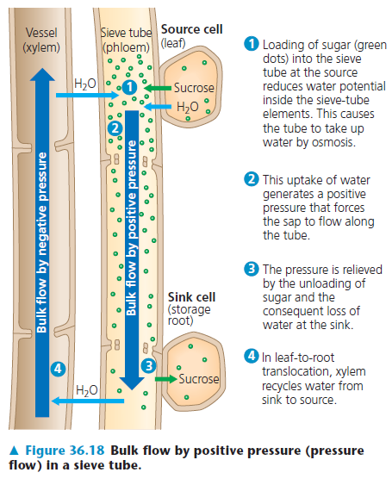

Slide 30
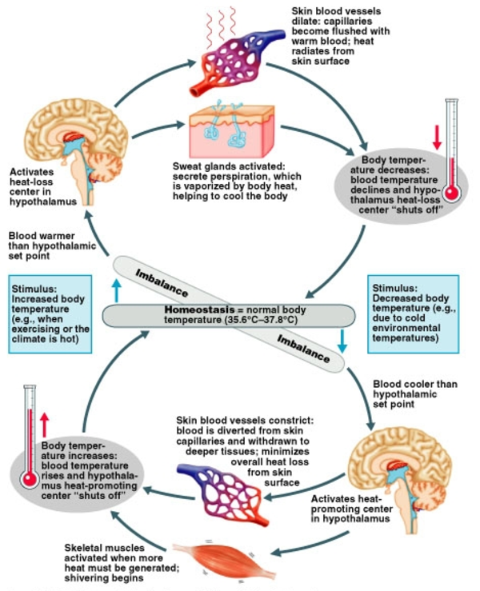
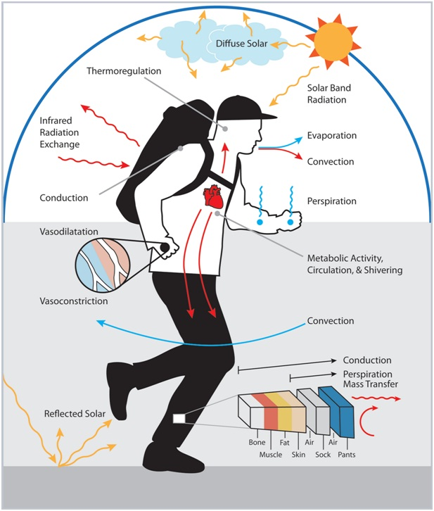
Heat Transfer

Slide 31
Herbivores
Global losses : Herbivore 18%, Insects 10% and
Other 8%
Fungi
Plants
Viruses
Other plants
Bacteria
Environmental factors

Slide 32
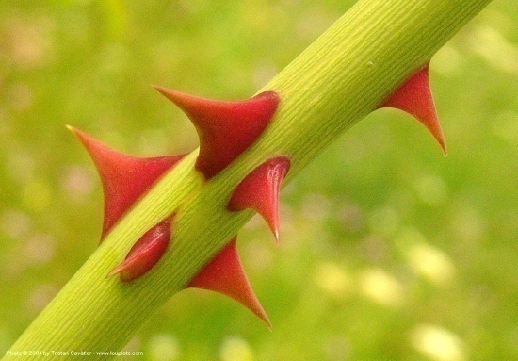
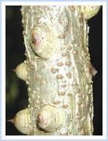
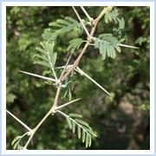
First line of defense in plants …
Outer structures: to keep the herbivores away (THORNS, SPINES AND PRICKLES) stationary weapons
Thorns - They are modifications of axillary Buds
Spines - Some plant organs like Stipules, Tips of leaves are modified
Prickles - Superficial outgrowths of epidermis

Slide 33
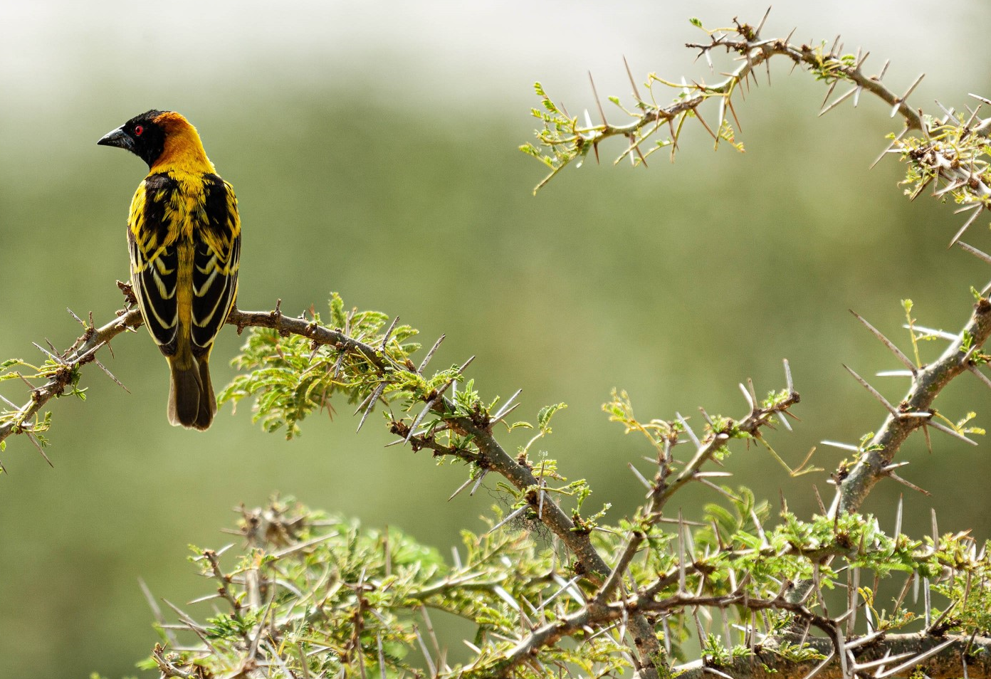

Slide 34
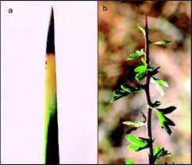
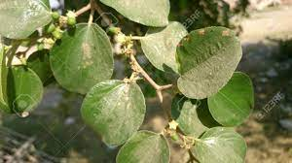
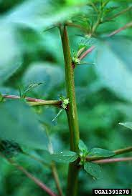
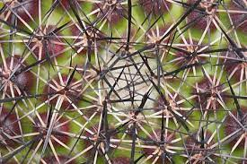
Positions of Spines, Thorns etc.
Apices of leaves e.g.. Date palm
On stems e.g.. Zizyphus spp
All over the stem e.g.. Amaranthus spinosus
On the lamina of leaves e.g. Solanum spp
On fruits e.g.. Solanum spp
Sometimes on roots e.g.. Acanthorhiza spp
All over the plant body e.g. Cactus

Slide 35
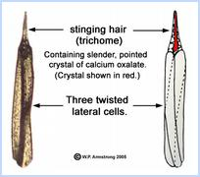
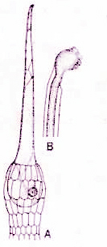
Stinging Hairs
Unicellular or multicellular epidermal hairs
They have a siliceous tip
Contain a poisonous sap
On contact with animal skins they pierce the skin and inject poisonous substance
Tragia involucrata (Euphorbiaceae)
Girardinia diversifolia (Urticaceae)
Leportea interrupta (Urticaceae)
Mucuna pruriens (Fabaceae)
Mucuna monosperma (Fabaceae)

Slide 36
Sticky Glandular Hairs
Epidermal outgrowths
Occur on leaves, stem, fruits etc.
They secret some sticky substance
Therefore, they are avoided by animals
e.g. Jatropha, Plumbago, Boerhaavia, Siegesbeckia etc.

Slide 37
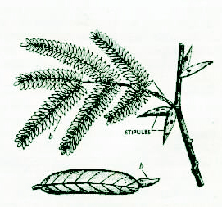
Myrmecophily
Symbiotic association between ants and plants
In Acacia sphaerocephala hollow spiny stipules work as shelters for the ants
Sometimes food is also provided to the ants
These ants protect the plant from other animals

Slide 38
Other external defenses
Dense covering of hairs (e.g. Calotropis)
Cork and Bark of many trees
Red colour of tender leaves
Protection to the growing points (e.g. Ficus)
Silica deposition in leaves of grasses
Rhaphides and sphaeraphides in aroides
Bitter taste and offensive smell

Slide 39
Internal defenses
Secondary metabolites like alkaloides e. g. Daturine in Datura, Nicotine in tobacco
Tannins present in Acacia sp, Terminalia chebula
Latex in many Asclepiads, Euphorbias etc.
Poisonous substances

Slide 40
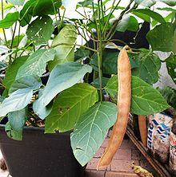
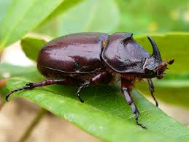
Arginine
Canavanine
Canavalia enciformis
Death of the insect ..

Slide 41
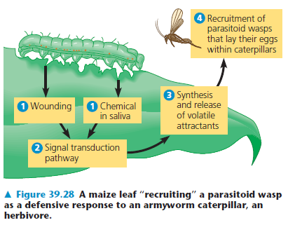
Defenses against herbivores ..

Slide 42
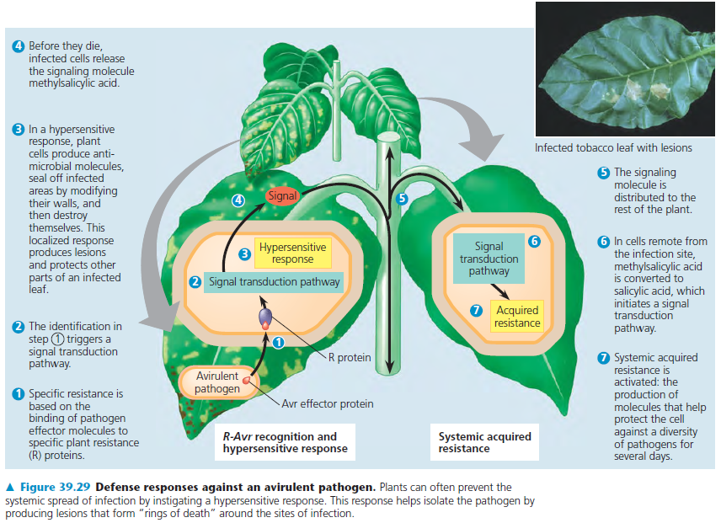

Slide 43
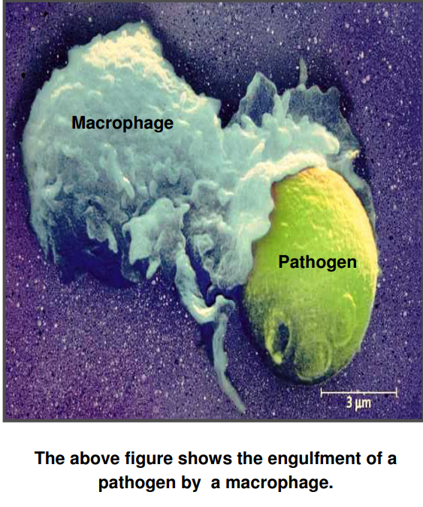
Defense System : Animals
Innate
Adaptive
Individual - Racial - Species
Active - Passive
Sensory
Digestive
Respiratory
Reproductive System
Lymphocytes (B&T)
Antigen Presenting Cells (Macrophage, B Cell, Dendritic cells)
Anatomic – Physiologic – Phagocytic BARRIERS

Slide 44
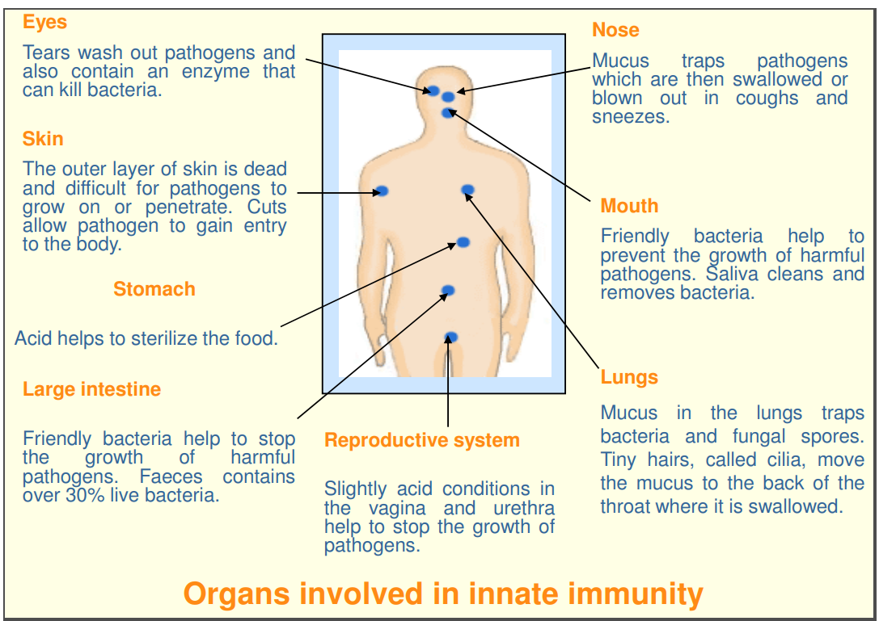

Slide 45
Anatomic
(Skin, Mucus Membrane)
Physiologic
(temperature, Low pH, Chemical Mediators)
Phagocytic
(Blood monocytes, neutrophils, Tissue macrophages)
Inflammatory

Slide 46
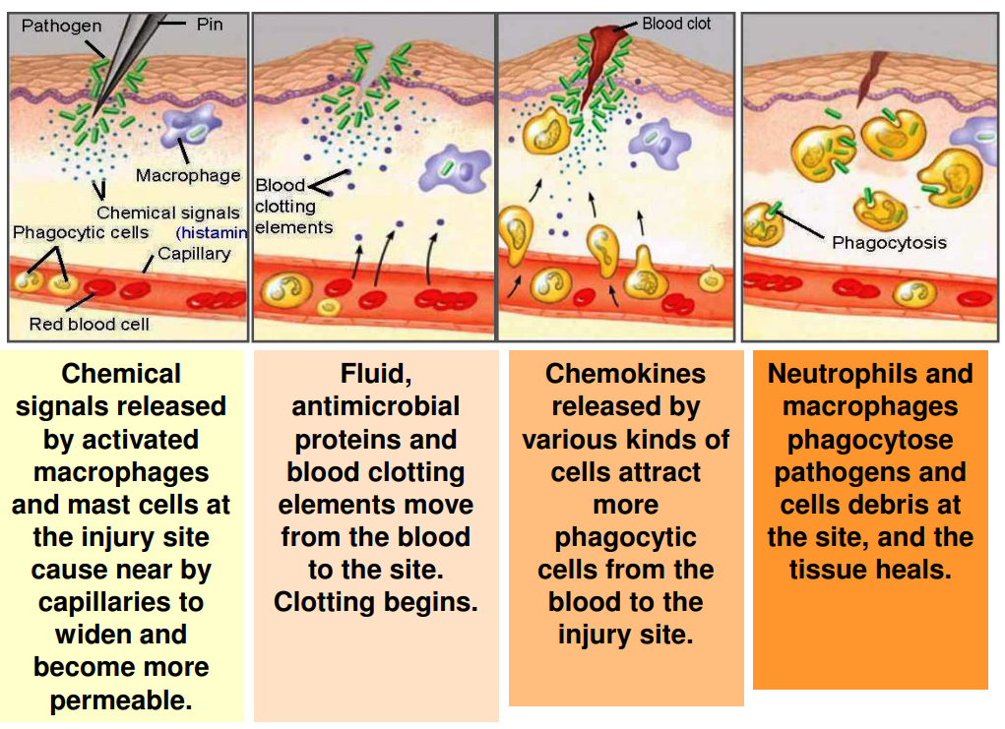

Slide 47
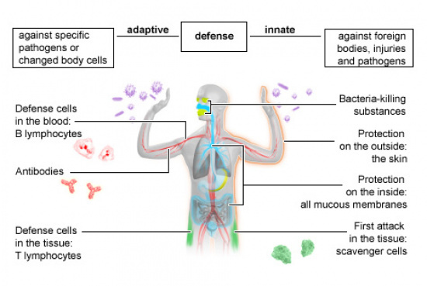
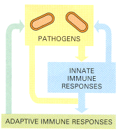

Slide 48
Innate Immunity
The innate immune system is the most evolutionarily conserved arm of the immune system and it generates rapid, non-specific inflammatory responses in response to signals from Pattern Recognition Receptors (PRR).
Pathogen Associated Molecular Patterns (PAMPs) are conserved molecular structures of bacteria, viruses and other pathogens that bind to PRRs.
The innate immune response has an important role in controlling infections during the first 7 days after an infection.
Many of the cells in the innate immune system (such as dendritic cells, macrophages, mast cells, neutrophils, basophils and eosinophils) produce cytokines or interact with other cells directly in order to activate the adaptive immune system.
There are other cell types, such as gamma-delta T cells and Natural Killer (NK) cells that are lymphocytes without antigen specificity, and therefore are considered to be innate cells with some similarities to effector lymphocytes.
The effector mechanisms used to clear an infection depend on the type of pathogen that has initiated the immune response.

Slide 49


Slide 50
Cell type | Attribute
White Blood Cells (Leucocytes) | independent, single-cell organisms like cells, cannot divide or reproduce on their own
Mast cells
Neutrophils
Phagocytes
Dendritic cells
Basophils & eosinophyls
Natural killer cells
Unconventional T cells

Slide 51
Immune system in plants | Immune system in animals
Plants cannot move to avoid predators, pathogens and neighboring plants | Animals can move to certain extent and avoid predators or fight
They lack immune system like animals as they have systemic acquired & hypersensitive responses | Innate system in all animals & adaptive system of immunity (in vertebrates)
Mechanical defense : structural & Chemical defenses | Physical and chemical defense mechanisms
Mainly led to phenomenal ability of plants to synthesize a vast range of organic compounds – secondary metabolites | Various organs like skin, eye, stomach, lungs, mouth etc. and conditions like pH, temperature, chemicals are involved.
Chemical defenses: distasteful or toxic compounds | Phagocytic or inflammatory barrier mechanisms

Slide 52
Innate Immune System | Adaptive Immune System
No antigen specific | Highly antigen specific
Limited number of receptors | Highly diverse receptors
Exposure to antigen results in no immunologic memory | Persistent memory with faster response of greater magnitude on subsequent infection
Quick: There is immediate maximal response | Late: There is a lag time between exposure and maximal response
Perfect: No microbe specific pattern in host is observed | Very good: occasional failure due to self/non-self discrimination results in to autoimmune disease
Major cell types are Phagocytes (monocytes, macrophages, neutrophils) NK cells, dendritic cells | T-cells (T C cells and T H cells), B-cells, APCs, NK cells)

Slide 53
Active Adaptive Immune System | Passive Adaptive Immune System
Produced actively by the host’s immune system. | Received passively by the host. No participation by the host’s immune system.
introduction by the infection or contact with immunogens | Conferred by introduction of readymade antibodies.
Affords durable and effective protection. | Protection is transient and less effective.
Immunity effective only after a lag period (time required for generation of antibodies). | Immunity effective immediately.

Slide 54


Bioelectric systems

Slide 55


